Slide 1
The DocEnhance Platform
Federica Bartolozzi European University Foundation

Slide 2
The DocEnhance platform (DEP)
A dynamic online space
Connecting the interests of different stakeholders
Facilitating information sharing
Notes:
The DocEnhance platform is a dynamic space with the aim of supporting innovative career-oriented PhD training. It does so by:
Connecting the interests of different stakeholders
Facilitating information sharing

Slide 3
What can you do with it?
Get access to free publicly available training resources
Easy adaptable to local need and PhD programmes
Dynamic existing network of academic and non-academic partners on PhD Hub platform
Notes:
The DocEnhance platform gathers all training resources produced during the project’s lifetime and effectively ensuring knowledge transfer. The training resources will be made freely available as open educational resources (OERs) and will be easily adaptable to the local needs of existing PhD programmes.
Currently the DEP is integrated with the PhDHub. The PhD Hub is a portal that centralises PhD positions, cooperation calls, events, funding opportunities, and more, bringing together a community of academic and non-academic partners across Europe. This integration ensures (I) a broader dissemination of the main DocEnhance outputs, (II) synergies between industry, research, and education as well as (III) meaningful networking opportunities.

Slide 4
How to access DEP?
Visit: https://courses.docenhance.eu/
Please remember to choose the ‘login with PhDHub’ option.
If you do not have a PhDHub account yet, you can create one at https://phdhub.eu/

Slide 5
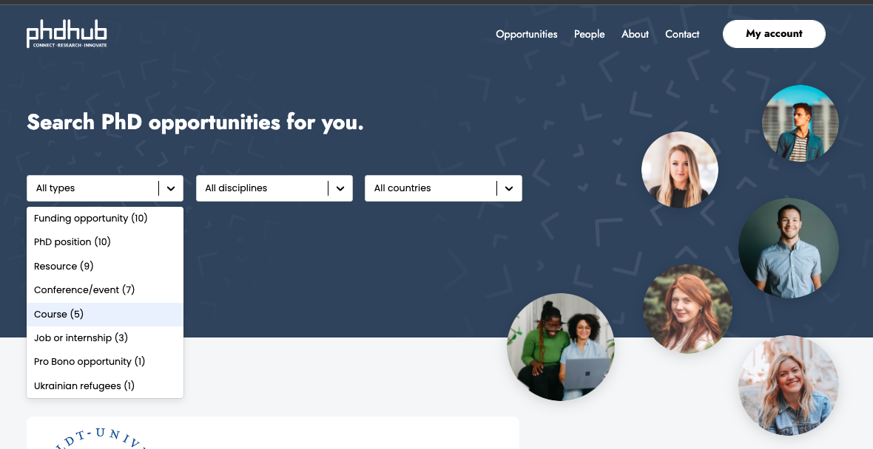
PhDHub
Notes:
The PhD Hub is a portal that centralises PhD positions, cooperation calls, events, funding opportunities, and more. As PhDHub and DocEnhance use the same login procedure, DocEnhance users can also fully exploit the featurs of PhDhub. This means that users can:
search opportunities, e.g., PhD positions, resources, jobs and internships, funding opportunities, etc.
create new opportunities
network with other registered users

Slide 6
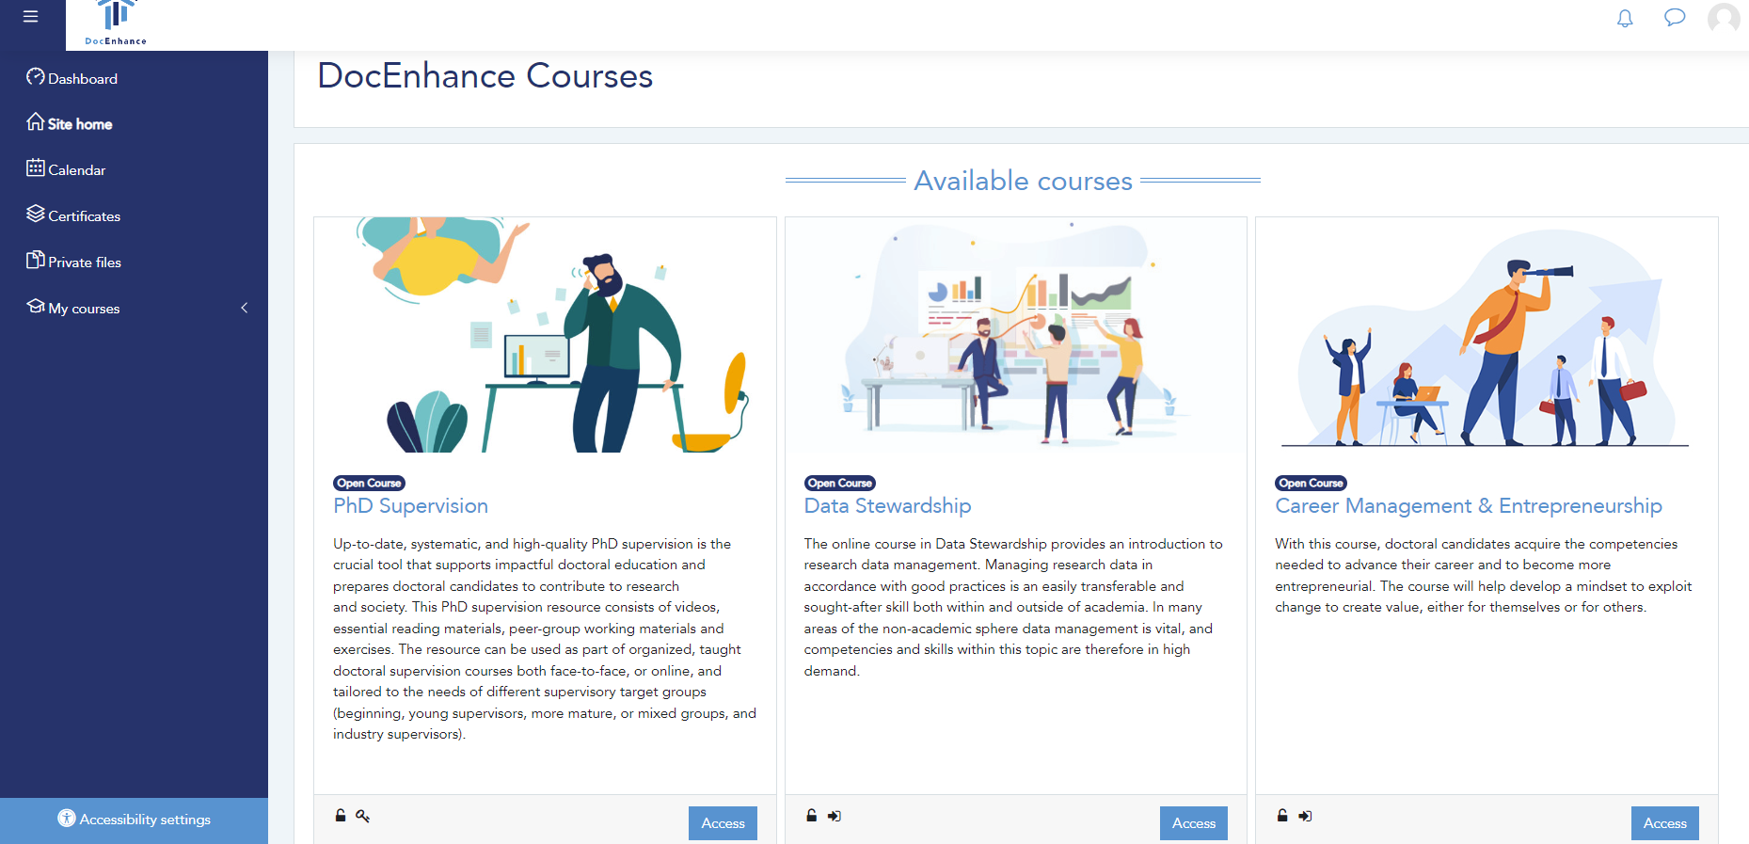
DocEnhance platform

Slide 7
Main features of DEP -
authenticated users
Browse courses
Enroll in a course as a student
See overview of courses in which you are enrolled
Notes:
The front page of the DocEnhance Moodle (https://courses.docenhance.eu/) references all the available courses
You can enroll in a course on the course page
Access your profile to see the courses in which you are enrolled

Slide 8
Main features of DEP -
students
Have same privileges as authenticated users
Participate in the course activities
Can receive a certificate upon course completion (depending on the course)

Slide 9
Main features of DEP - teachers
Request course creation
Import content from outside DEP
Add course material
Notes:
A Course can be created by the platform Administrator following a user request
Teachers that have already a course backup from another Moodle environment can import their courses in the DocEnhance Moodle.
Teachers can add various resources, e.g., videos, presentations, and various documents, as well as activities such as forums or quizzes to a course.

Slide 10
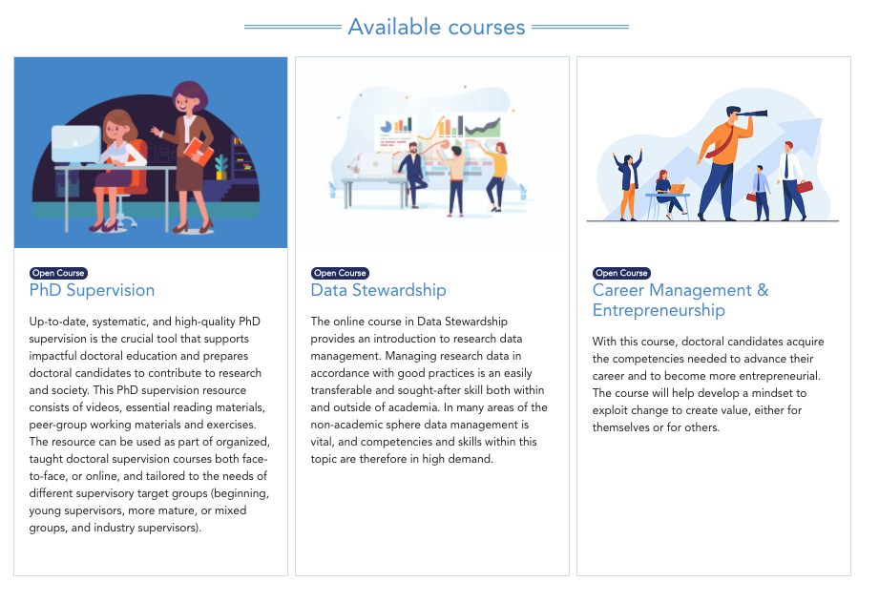
3 Pilot courses available on transferable skills
PhD Supervision
Data
Stewardship
Career Management &
Entrepreneurship
Notes:
Currently, the DEP platform includes three courses:
PhD Supervision, focusing on how supervisors can best mentor and support doctoral candidates;
Data Stewardship, providing good practices and training on how to manage research data;
Career Management & Entrepreneurship, helping doctoral candidates planning their career after their PhD and improving their entrepreneurial skills.

Slide 11
Thank you!

