Slide 1
Introduction to DocEnhance
Hanne Risan Johnsen DocEnhance Coordinator

Slide 2
Responding to the need for PhD training in transferable skills
Impact was expected on post-graduate candidates and early-stage researcher careers, in closing the skills gap between research employment in academia and beyond academia

Slide 3
Transferable skills courses and employability beyond academia
Transferable
skills

Slide 4
The development process in co-creation with our stakeholders

Slide 5
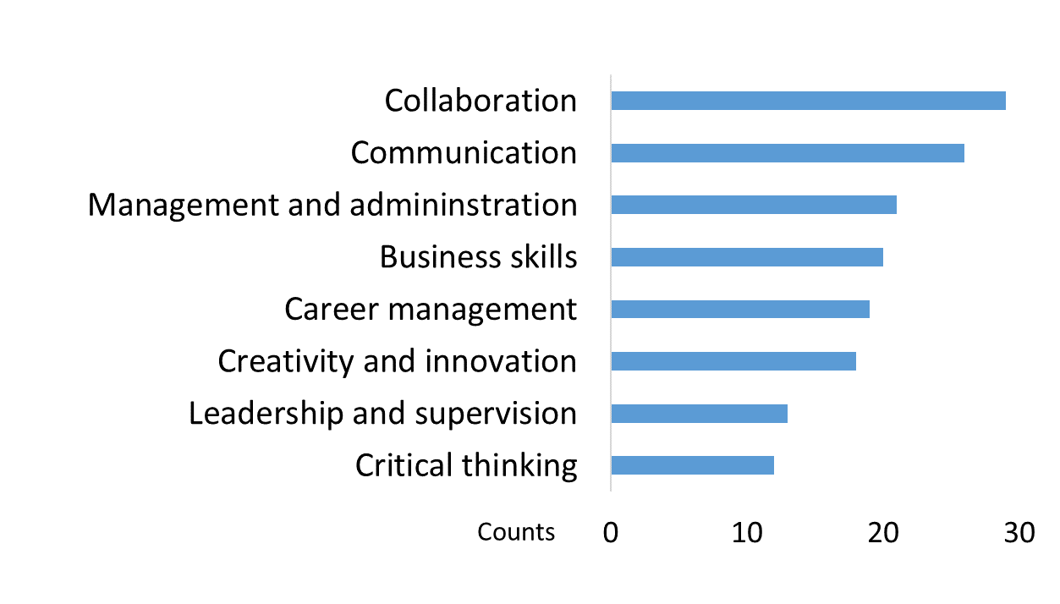
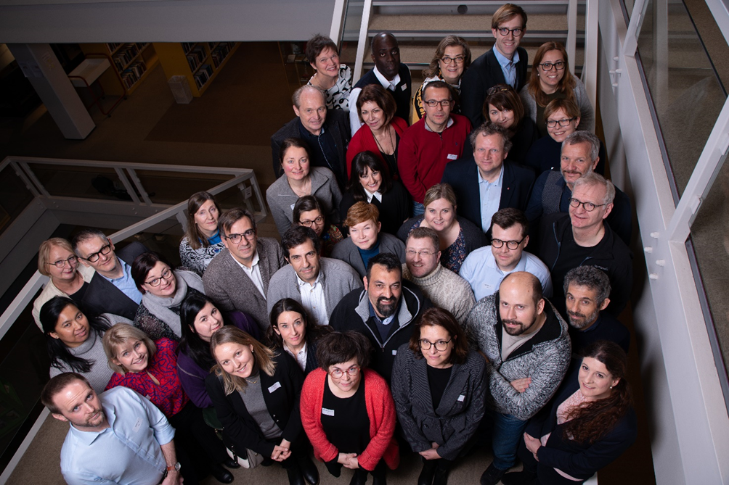
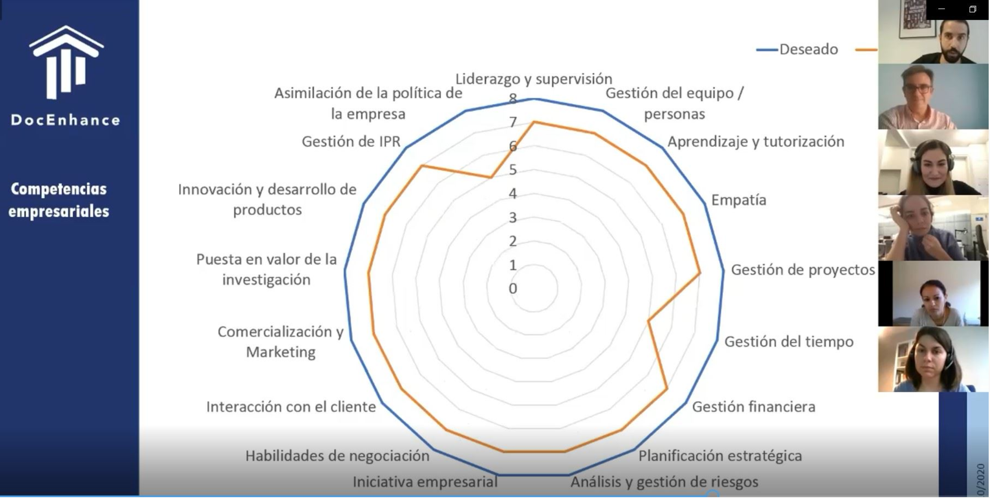
Stakeholder interaction
Pre-assessment on skills gaps
Internal stakeholder meeting
Five regional stakeholder meetings

Slide 6
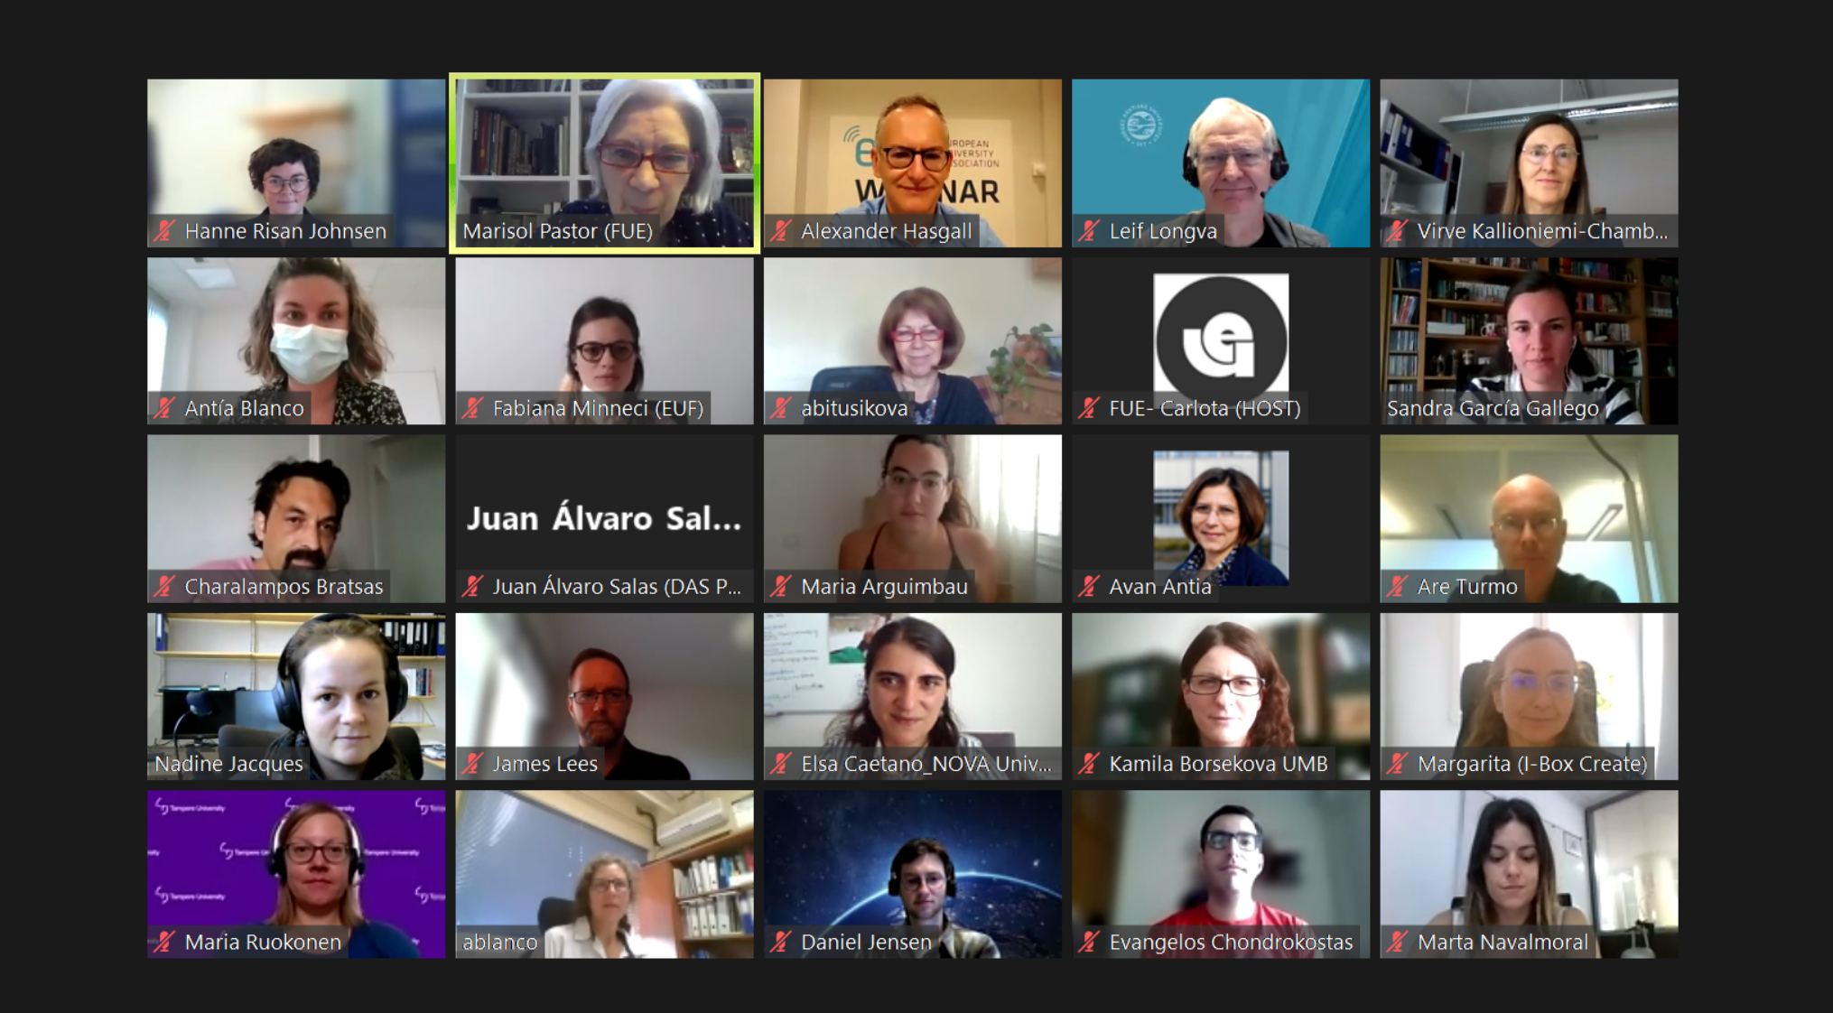
Stakeholder interaction
Implementation of pilot courses
Stakeholder evaluation and validation

Slide 7
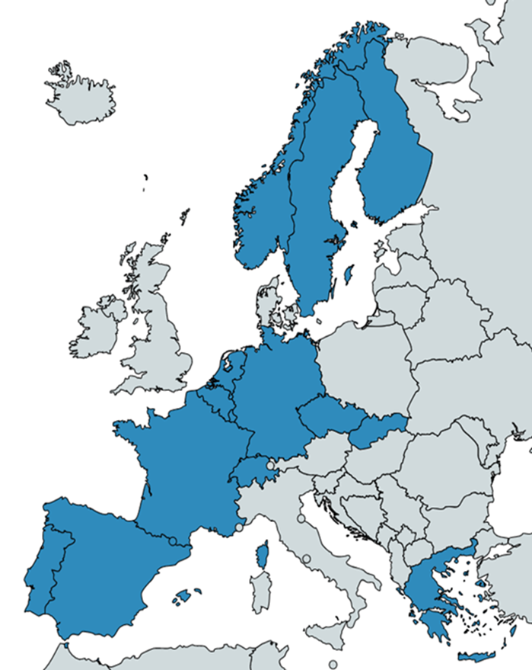
An international consortium of 19 partners
Universities
Academic organisations
Organisations with expertise in career transition and non-academic collaboration
SMEs within PhD training, innovation and open science

Slide 8
The DocEnhance Platform
Mobility
Interdiciplinarity
Open education

Slide 9
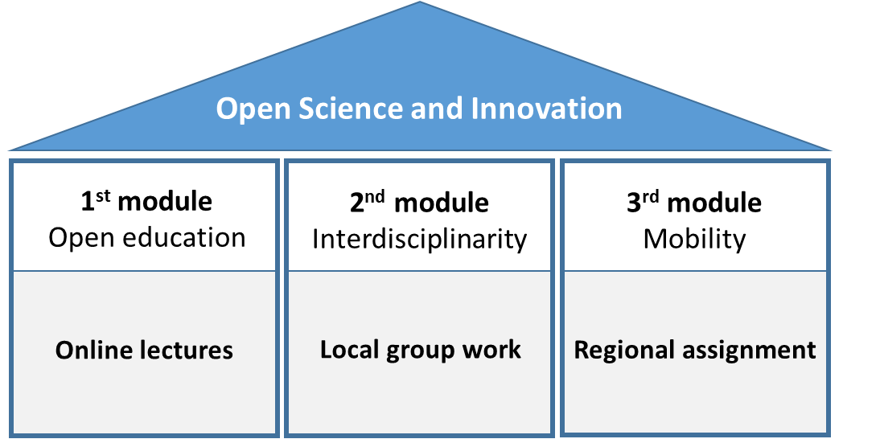
Course concept

Slide 10
Design of 3 pilot courses
on transferable skills for PhD candidates/supervisors
Data Stewardship
Career management & entrepreneurship
Supervision

Slide 11
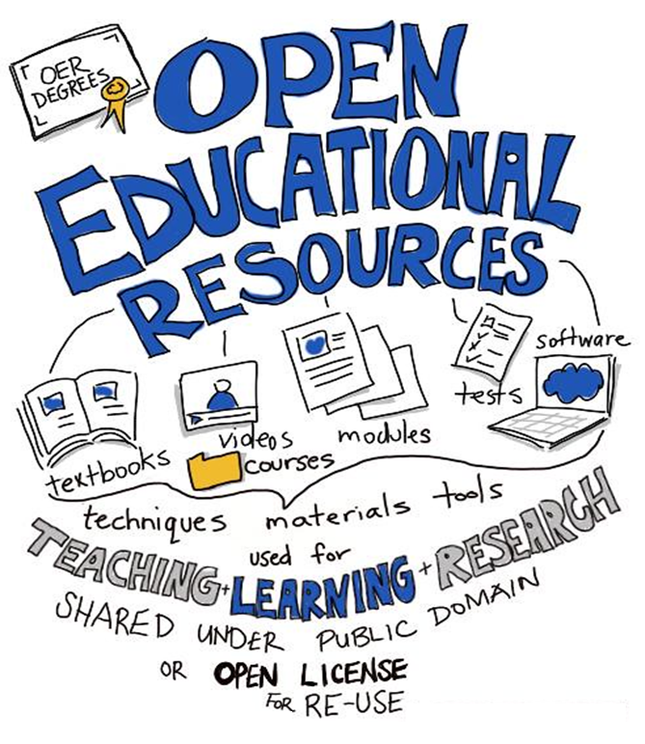
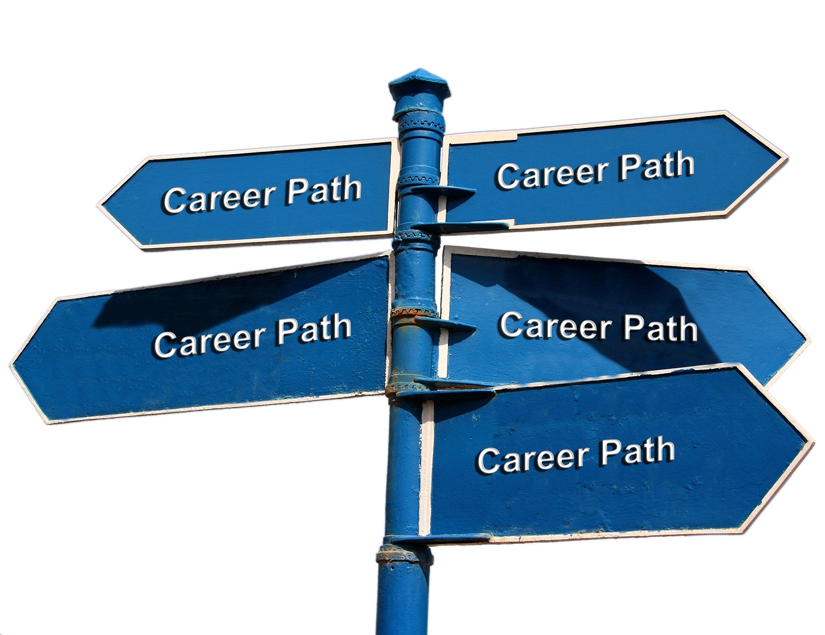
The DocEnhance Platform
Mobility
Interdiciplinarity
Open education

Slide 12
Impact and future perspectives
All outcomes open access for everyone to utilize
Roadmap for implementation of the DocEnhance resources
Implementation of the courses at partner universities
European voluntary standard (CWA)
DocEnhance concepts to be further developed in Horizon Europe project, DocTalent4EU (kick-off January 2023)

Slide 13
The DocEnhance Platform Federica Bartolozzi, European University Foundation Course in Data Stewardship Leif Longva, UiT The Arctic University of Norway Course in Career Management and Entrepreneurship Marco Masia, University of Vienna Course in PhD Supervision Pirjo Nikander, Tampere University The DocEnhance Career-tracking Survey Julia Boman, European Science Foundation

